Slide 1
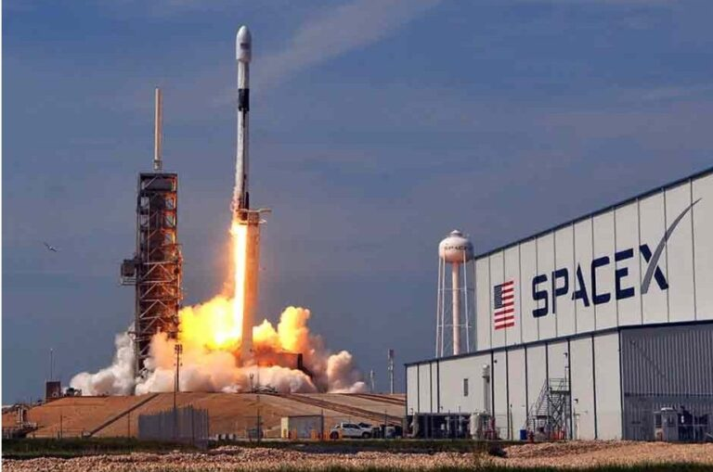

Data Science Capstone Project:
SpaceX Falcon 9 First Stage Landing Prediction
Obiamaka Ugwumba
April 9, 2022
Background Image: https://www.capstoneaxis.com/success-and-failures-of-space-x/

Slide 2
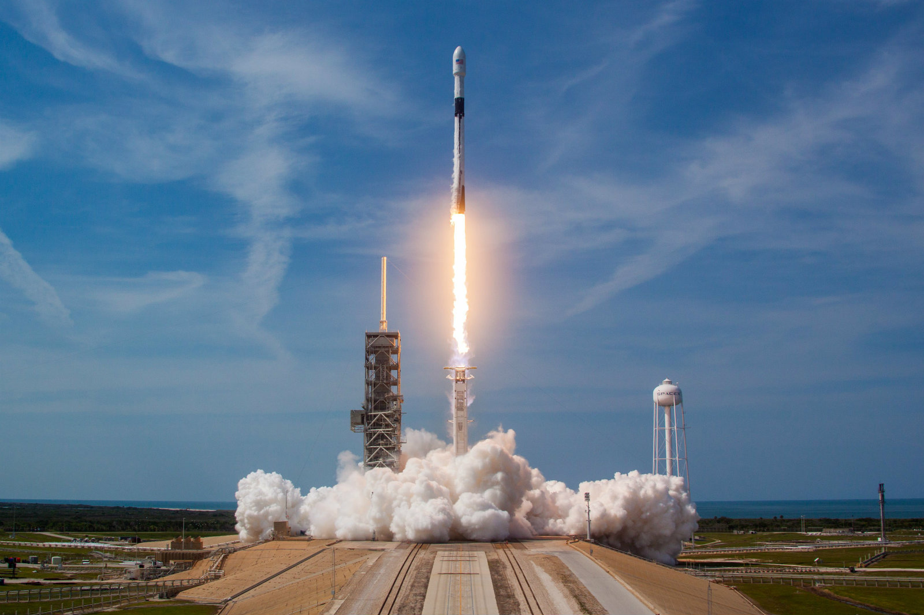
Outline
Executive Summary
Introduction
Methodology
Results
Conclusion
Appendix
Background Image: https://www.capstoneaxis.com/success-and-failures-of-space-x/

Slide 3

Executive Summary
This Capstone Project is to predict the first stage landing success rate for SpaceX Falcon9 which will also help determine the cost of a launch in comparison with other providers.
The methodologies implemented for this task are:
a. Data Collection, Web Scraping, and Wrangling
b. Exploratory Data Analysis and Visualization
c. Interactive Data Visualization with Folium
d. Predictive Analysis (Classification)
Summary of all results:
- The data displays the relationship between features such as Flight Number and
Pay load mass as well as Flight Number and Launch Site among other factors like
orbit type, location, and proximity to the launch site that may impact the success
rate of the first stage land.
- Additionally, our predictive analysis indicated that the best machine learning model for first stage landing for SpaceX Falcon9 is the
Decision Tree.

Slide 4
Introduction
In this project, the aim was to predict the landing success of the first stage SpaceX Falcon9. Currently, SpaceX advertises Falcon9 rocket launches at a cost of 62 million dollars. In contrast, other providers market cost is an upward of 165 million dollars each. SpaceX launch costs are lower due to the reuse of the first stage. Hence, determining if the first stage will land successfully will also determine the cost of a launch.
Most unsuccessful landings are planned and SpaceX performs a controlled landing in the Ocean.
This brings us to the main question: Given launch record values such as flight number, launch site, payload, payload mass, orbit, launch outcome, etc. Can we predict the first stage landing success?

Slide 5
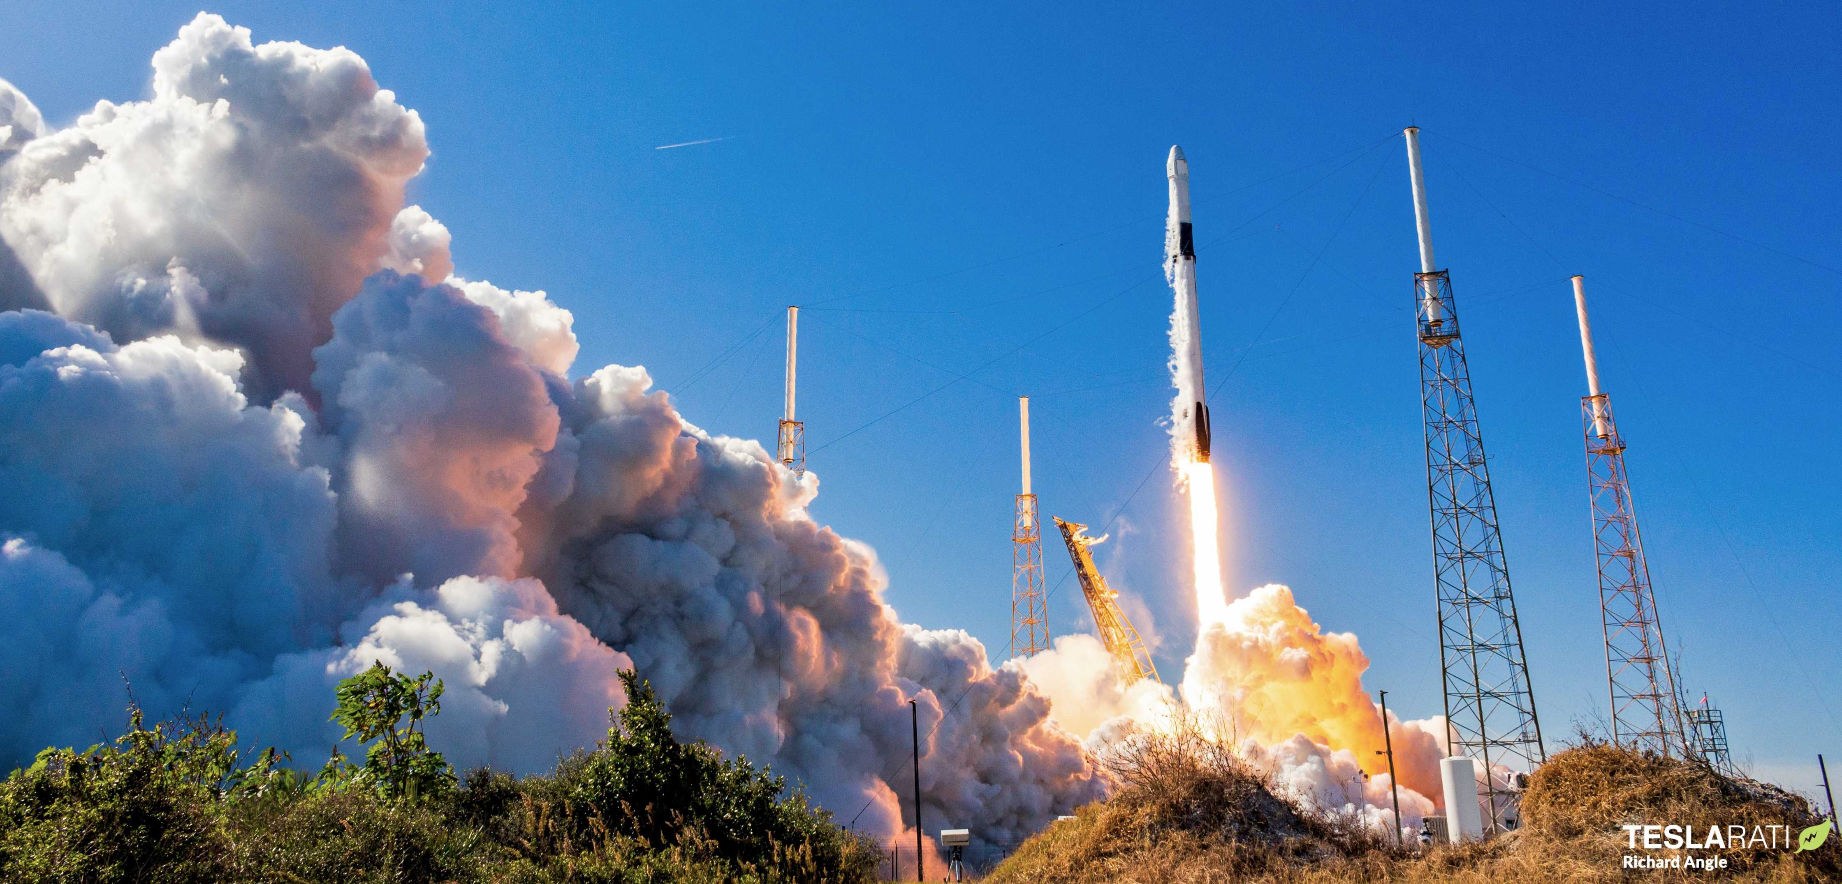
Section 1
Methodology
Background Image: https://www.teslarati.com/spacex-falcon-9-booster-launch-debut-photos/

Slide 6
Methodology
The methodology used for out findings are:
1. Data collection and wrangling methodology:
a. SpaceX API
b. Web Scraping
c. Data Wrangling
2. Perform exploratory data analysis (EDA) using visualization and SQL
a. SQL
b. Pandas
c. Matplotlib
3. Perform interactive visual analytics and dashboarding
a. Folium
b. Plotly Dash
4. Perform predictive analysis using classification models
a. Logistic Regression
b. Decision Tree
c. Support Vector Machine
d. K-nearest neighbors (KNN)

Slide 7
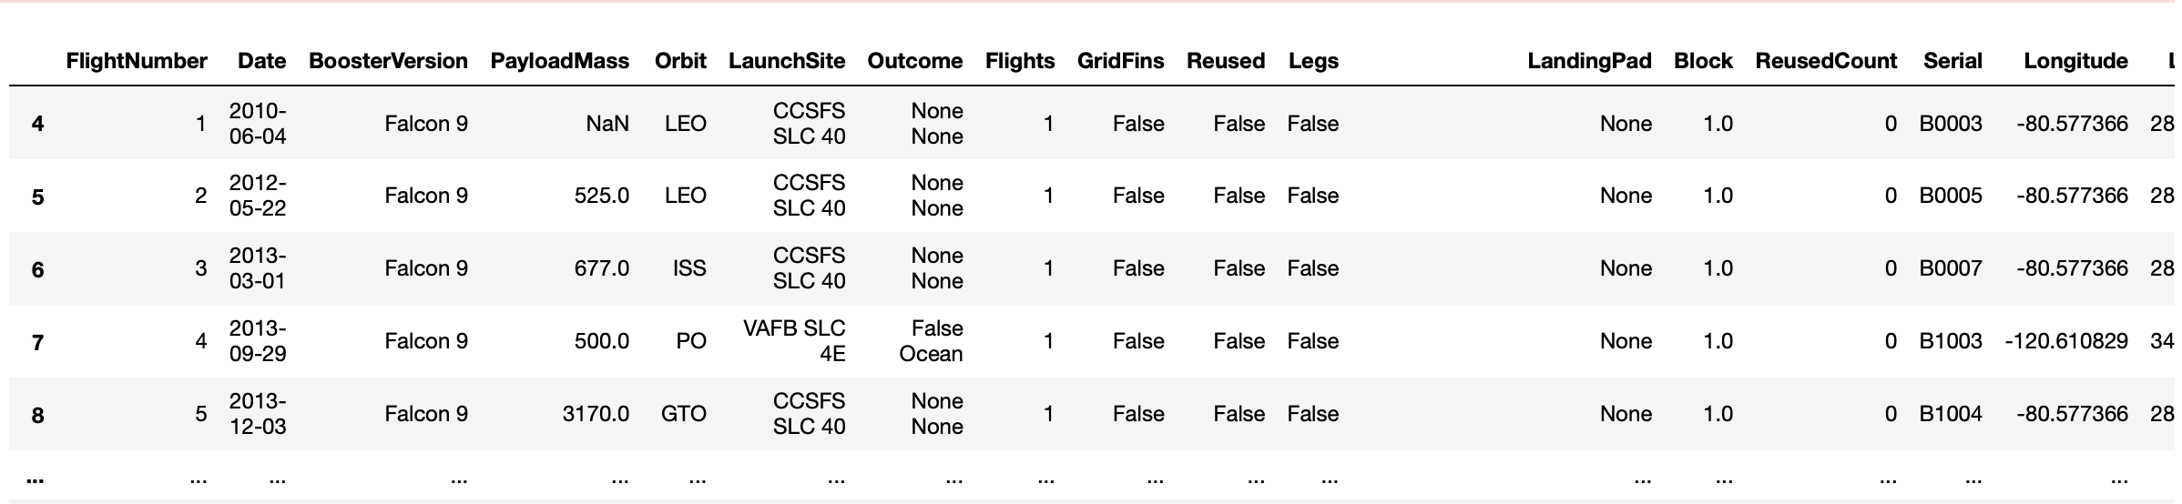
Data Collection – SpaceX API
The API used: "https://api.spacexdata.com/v4/launches/past
The API included a lot of information about SpaceX launches, requesting and parsing the SpaceX launch data, filtering the data to only include Falcon9 launches and eliminating Falcon1 yielded results.
The results included 90 Rows, 17 columns to include Flight Number, Date, Booster Version, etc.

Slide 8
Data Collection – Web Scraping
For the web scraping process we used the wikipedia link: https://en.wikipedia.org/wiki/List_of_Falcon\_9\_and_Falcon_Heavy_launches
After requesting the HTML page from the above URL and we want to collect all relevant column names from the HTML table header.
Our column names: Flight No, Date and time, Launch site, Payload, Payload mass, Orbit, Customer, Launch outcome.
HTML tables in Wiki pages will most likely contain unexpected annotations and missing values N/A, inconsistent formatting, etc. this is a factor to consider while web scraping.

Slide 9
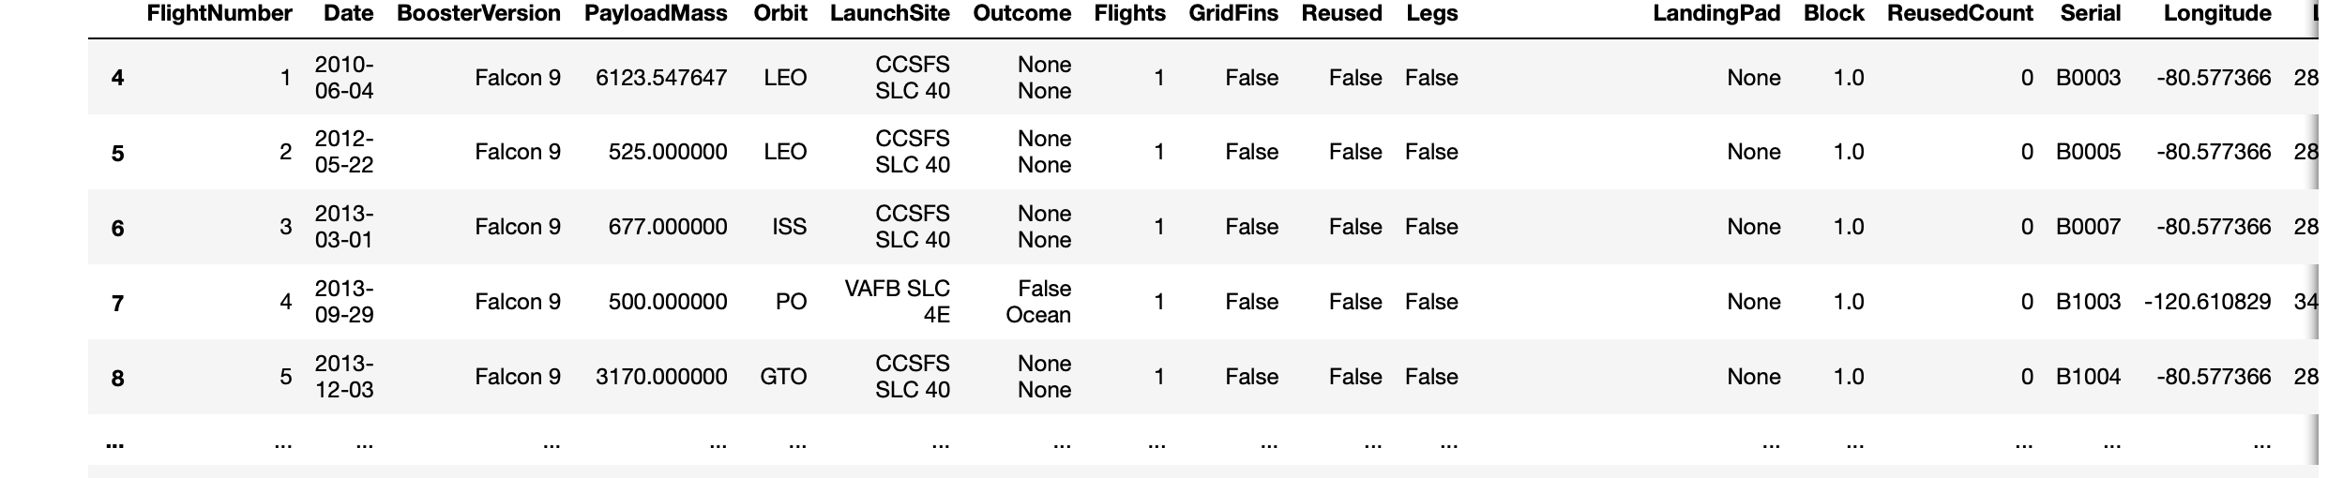
Data Collection – Data Wrangling
Data wrangling process pertained to the missing values in the dataset.
- calculating the mean of the Payload Mass and use it to replace the missing values
in the data.
- The number of Payload Mass missing changes to zero
- The landing pad column will still contain the None values representing the landing pads that
were not used.

Slide 10
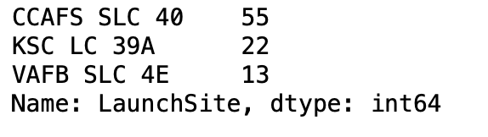
Data Wrangling
During this process we want to find some patterns in the data using EDA.
There have been several cases where the booster did not land successfully. Sometimes a landing was attempted but failed due to an accident.
Thus, after loading the dataset, calculate the percentage of the missing values, then we calculate the number of launches at each site.

Slide 11
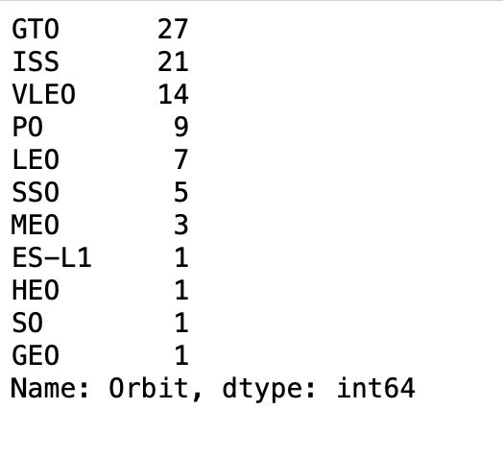
Data Wrangling
Next, we calculate the number and occurrences of each orbit because each launch aims to a dedicated orbit such as: LEO, GTO, SSO, etc.

Slide 12
Data Wrangling
Next, we calculate the number and occurrence of mission outcome per orbit type.
- The results are as follows:
a. True Ocean means the mission outcome was
successfully landed in the ocean.
b. False Ocean means the mission outcome was
unsuccessfully landed in the ocean.
c. True RTLS means the mission outcome was
successfully landed to a ground pad.
d. False RTLS means the mission outcome
was unsuccessfully landed to a ground
pad.
e. True ASDS means the mission outcome
was successfully landed to a drone ship.
f. False ASDS means the mission outcome
was unsuccessfully landed to a drone
ship.
g. None ASDS and None None represent a
failure to land.

Slide 13
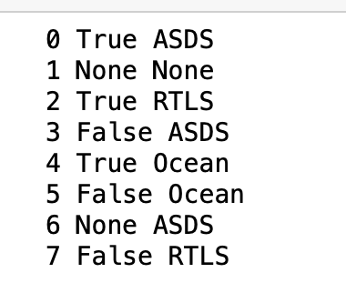
Data Wrangling
Next, we calculate the number and occurrence of mission outcome per orbit type.
- The results are as follows:
* There are 7 False RTLS meaning that the mission
was unsuccessful in landing on the ground pad
* 0 True ASDS implies that there were none that
landed on a drone ship.
* 3 False ASDA meaning they were unsuccessful
lands on the drone ships.
* 4 True Ocean means those were successful in ocean
* 2 True RTLS means successful landing on the ground
pad.

Slide 14
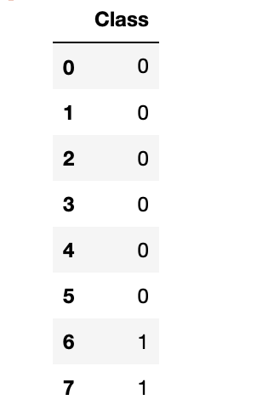
Data Wrangling
Next, we create a landing outcome label from Outcome column
The code will generate a “zero” for a bad outcome and a “one” for the successful first stage landing outcome.
We can use this ”class” data to calculate the success rate mean: 0.6666666666666666

Slide 15
Exploratory Data Analysis and Visualization
SQL was used to query the data and answer questions about the launch:
- The unique launch sites.
- Pay load mass carried by the Boosters launched by Nasa.
- Avg Pay load mass
- Total number of successful and failed missions
Pandas software library was used for data manipulation and analysis

Slide 16
Exploratory Data Analysis and Visualization
Matplotlib is a plotting library used to plot out FlightNumber vs. PayloadMass
Seaborn is a Python data visualization library, based on matplotlib, providing a high-level interface for drawing attractive and information.
These libraries were used to visualize data in the form of scatterplots, bar charts, and line graphs.
With these were are able to visualize Flight Number vs Pay Load Mass, Flight Number vs Launch Site etc.

Slide 17
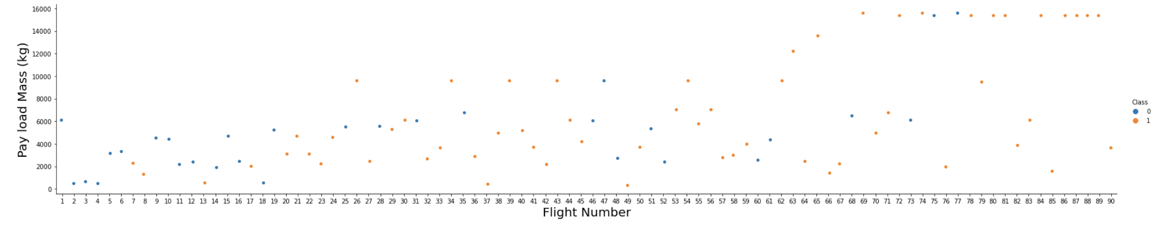
Exploratory Data Analysis and Visualization

Slide 18
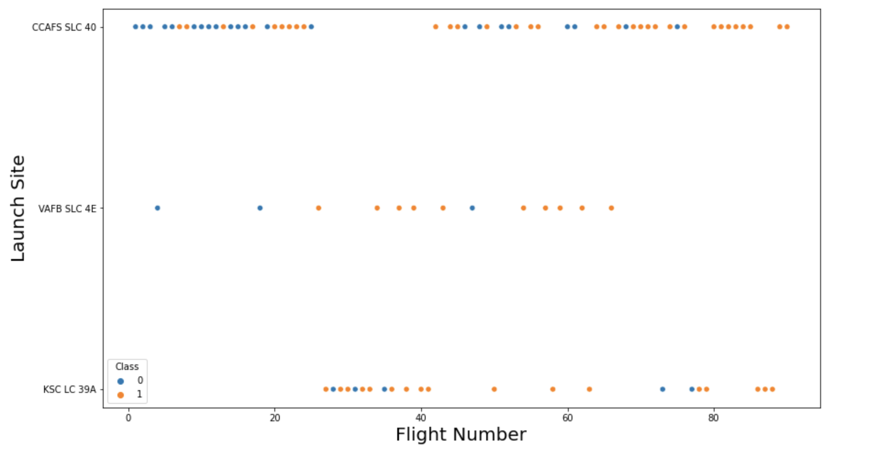
Exploratory Data Analysis and Visualization
We can also visualize the relationship between Flight Number and Launch Site.

Slide 19
Exploratory Data Analysis and Visualization
Folium is an interactive library used to visualize data through the use of maps.
This library was used to:
- Mark all launch sites on a map
- Mark the success/failed launches for each site on the map
- Calculate the distances between a launch site to its
proximities

Slide 20
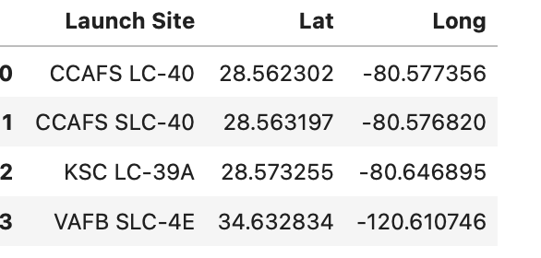
Exploratory Data Analysis and Visualization
Folium is an interactive library used to visualize data through the use of maps.

Slide 21
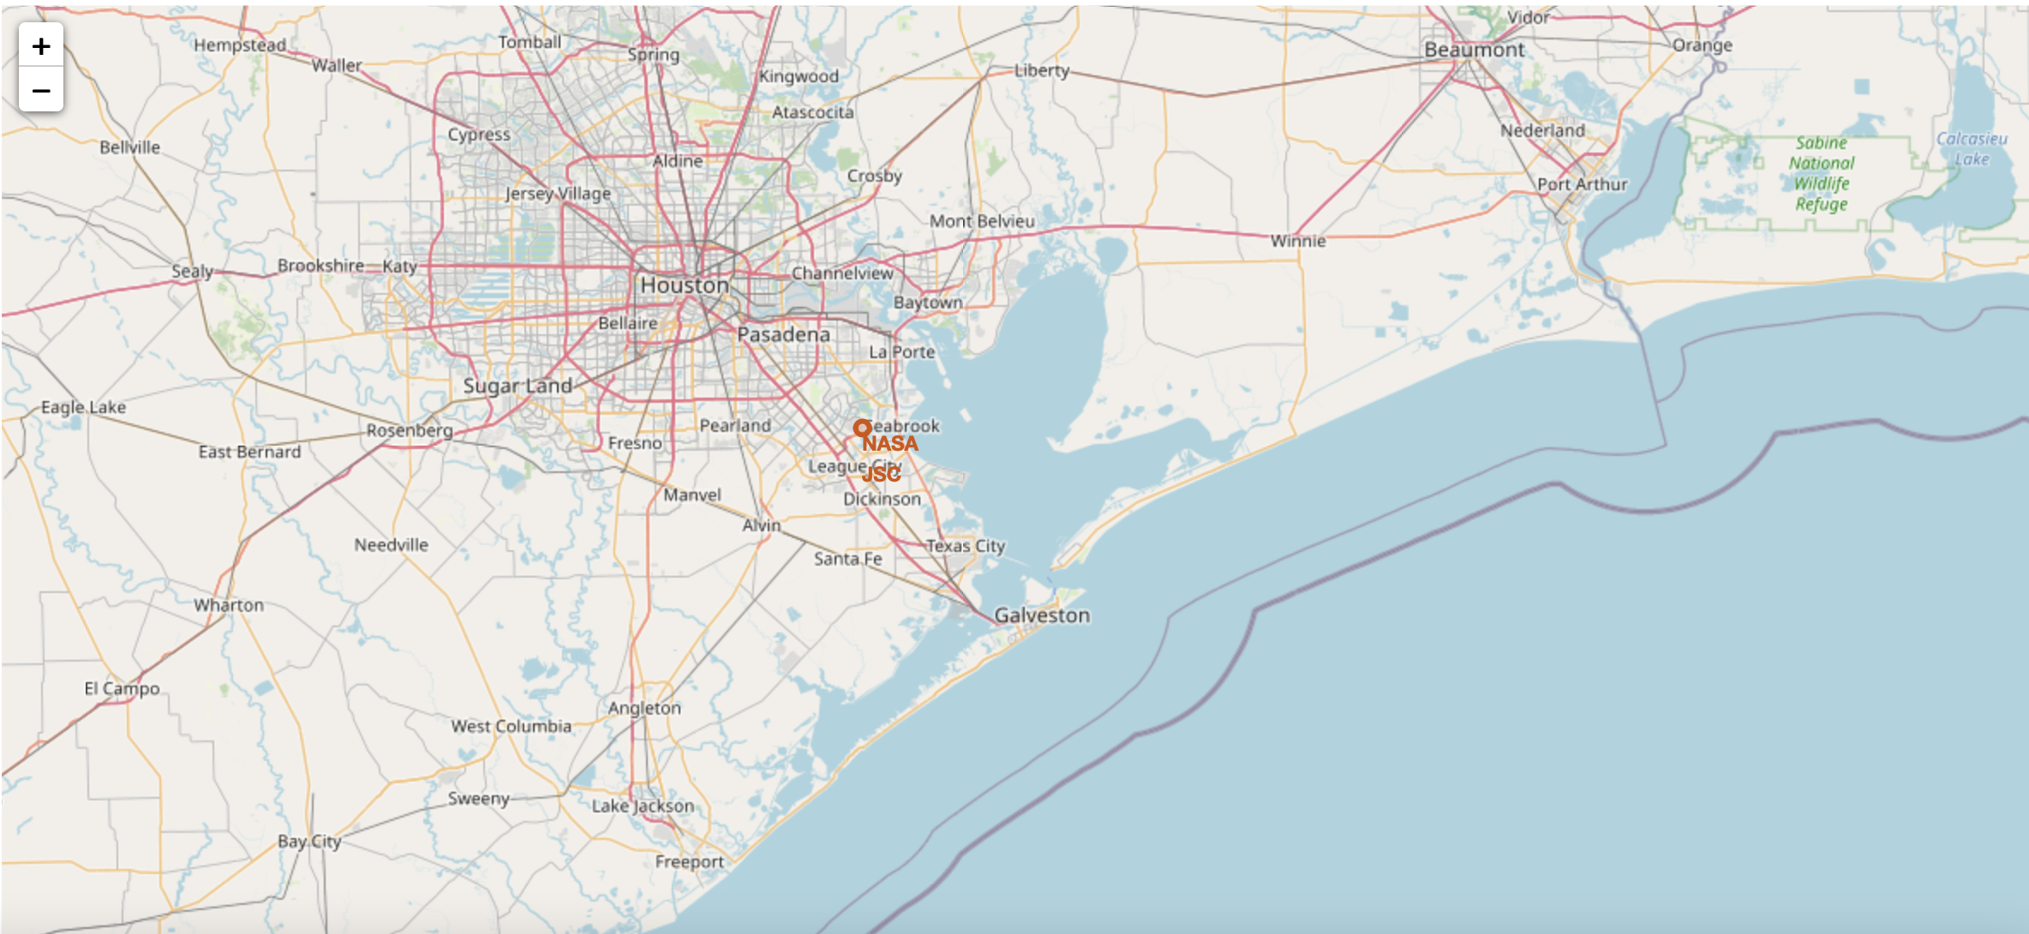
Interactive Map with Folium

Slide 22
Build a Dashboard with Plotly Dash
The Dashboard was used to generate an interactive site that permits us to toggle the input with the dropdown menu and range slider.
It was also useful in creating a pie chart and scatterplot illustrating the outcome of the launches.
Ploty Dash was able to provide:
- Total launch success from individual launch sites
- Displays the correlation between payload mass and mission outcome
- It visually depicted successes and failliures

Slide 23
Predictive Analysis (Classification)
To perform predictive analysis the steps is as follows:
- Perform exploratory Data Analysis and determine Training Labels
- create a column for the class
- Standardize the data
- Split into training data and test data
-Find best Hyperparameter for
1. Support Vector Machine (SVM)
2. Decision Classification Trees
3. Logistic Regression
4. K Nearest Neighbor(KNN)
- Find the method performs best using test data
- Illustrate the best results using accuracy tests and confusion matrix.

Slide 24
Results
The sections to follow illustrate the results in the order:
Exploratory Data Analysis Using SQL
Launch Sites and Proximity Analysis
Folium
Ploty Dash
Predictive Analysis

Slide 25
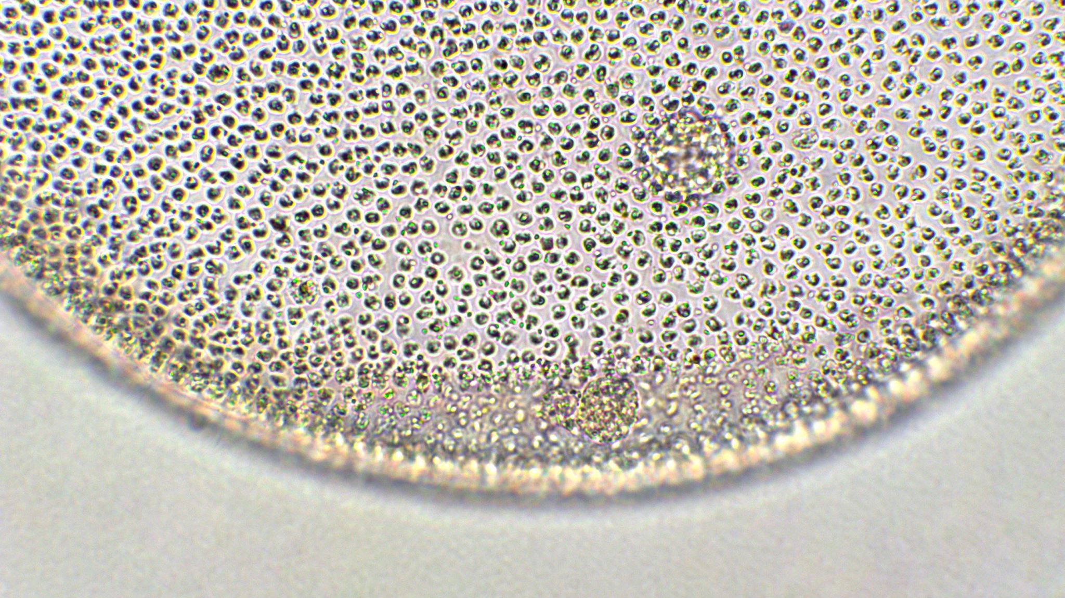
Insights drawn from EDA
Section 2

Slide 26
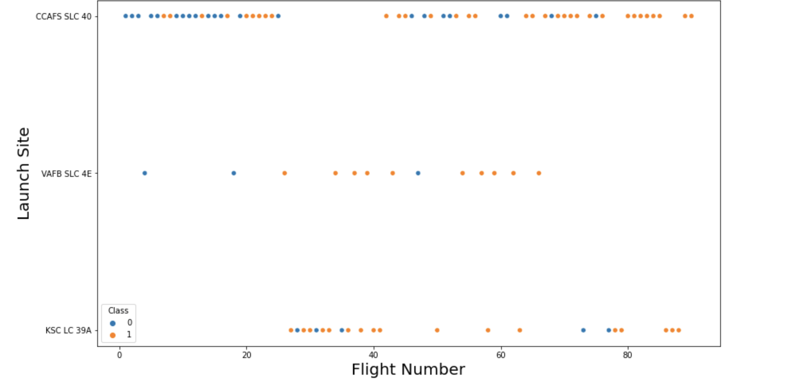
Results: Data Visualization (Matplotlib & Seaborn)
Flight Number vs. Launch Site

Slide 27
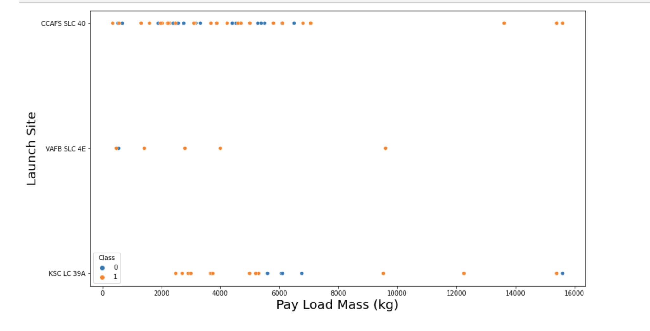
Results: Data Visualization (Matplotlib & Seaborn)
Payload vs. Launch Site - for the VAFB-SLC launchsite there are no rockets launched for heavy pay load mass(greater than 10000).

Slide 28
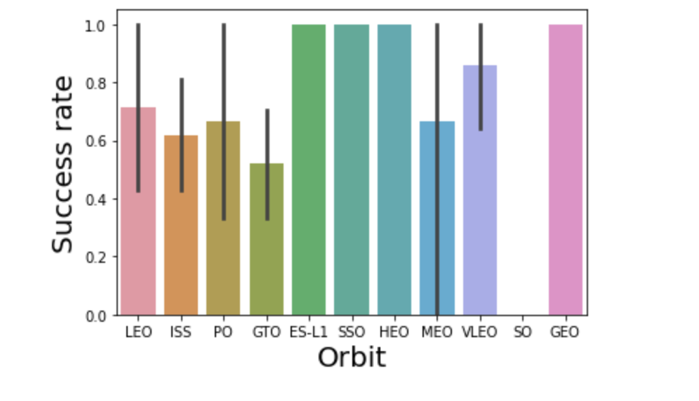
Results: Data Visualization (Matplotlib & Seaborn)
Success Rate vs. Orbit Type

Slide 29
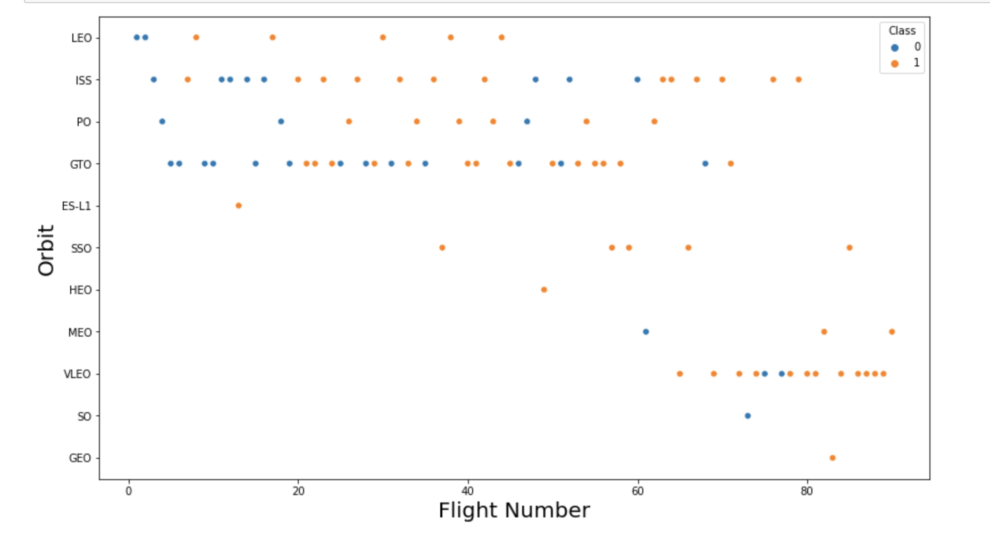
Results: Data Visualization (Matplotlib & Seaborn)
Flight Number vs. Orbit Type - the success of the LEO orbit appears related to the number of flights; on the other hand, there seems to be no relationship between flight number when in GTO orbit.

Slide 30
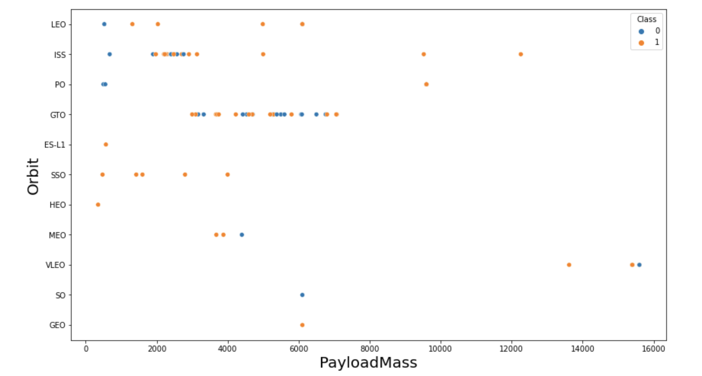
Results: Data Visualization (Matplotlib & Seaborn)
Payload vs. Orbit Type:
- With heavy payloads the successful landing or positive landing rate are
more for Polar, LEO and ISS.
- However, for GTO we cannot distinguish this well as both positive landing
rate and negative landing(unsuccessful mission) are both there here.

Slide 31

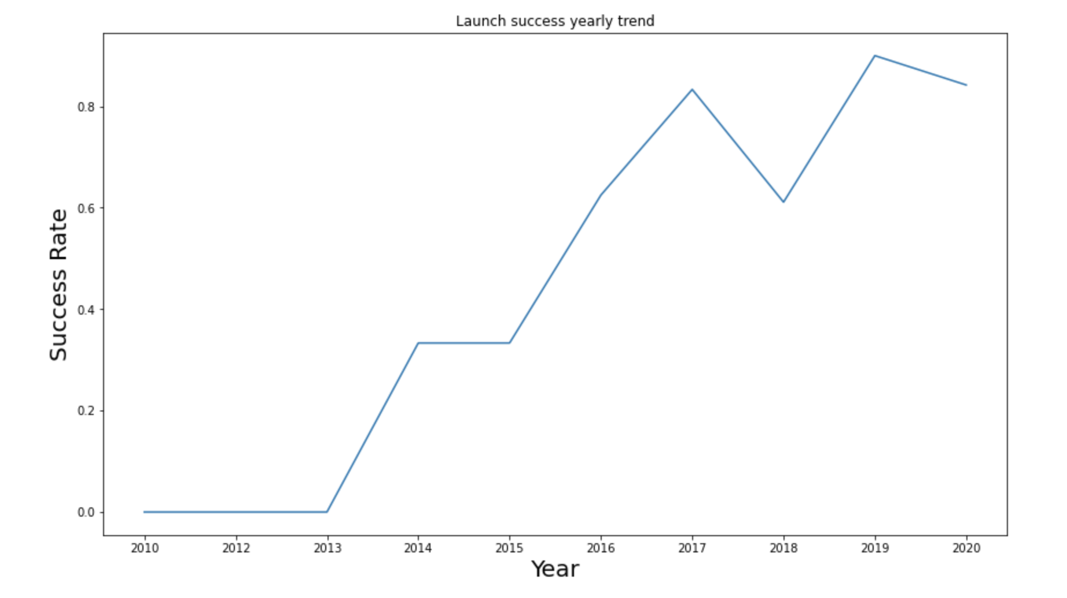
Results: Data Visualization (Matplotlib & Seaborn)
Launch Success Yearly Trend - you can observe that the success rate since 2013 kept increasing till 2020

Slide 32
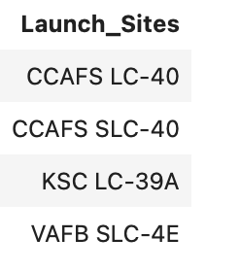
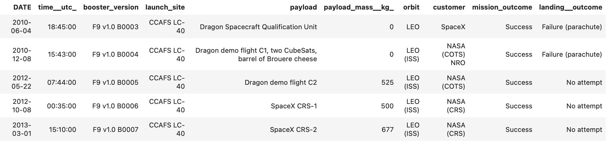
Results: EDA with SQL
All Launch Site Names:
Launch Site Names Begin with ‘CCA’

Slide 33
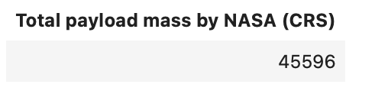
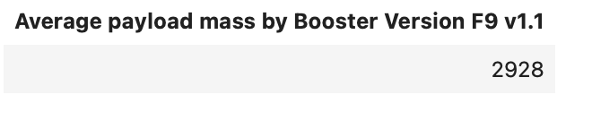
Results: EDA with SQL
Total Payload Mass:
Average Payload Mass by F9 v1.1

Slide 34
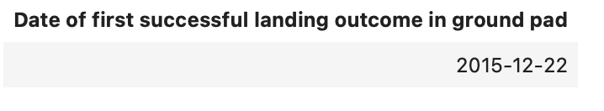
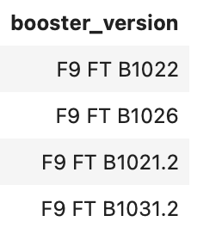
Results: EDA with SQL
First Successful Ground Landing Date
Successful Drone Ship Landing with Payload between 4000 and 6000:

Slide 35
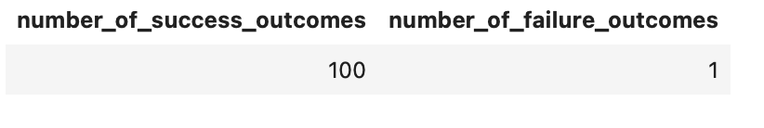
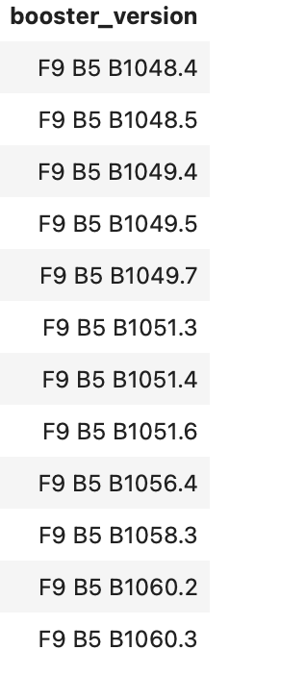
Flight Number vs. Launch Site
Total Number of Successful and Failure Mission Outcomes:
Boosters Carried Maximum Payload:

Slide 36
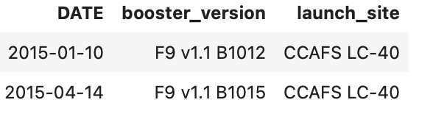
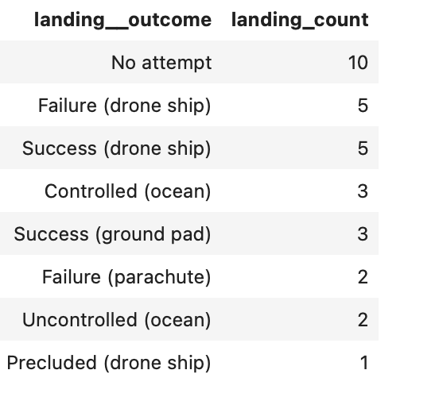
Flight Number vs. Launch Site
2015 Launch Records:
Rank Landing Outcomes Between 2010-06-04 and 2017-03-20

Slide 37

Launch Sites Proximities Analysis
Section 3

Slide 38
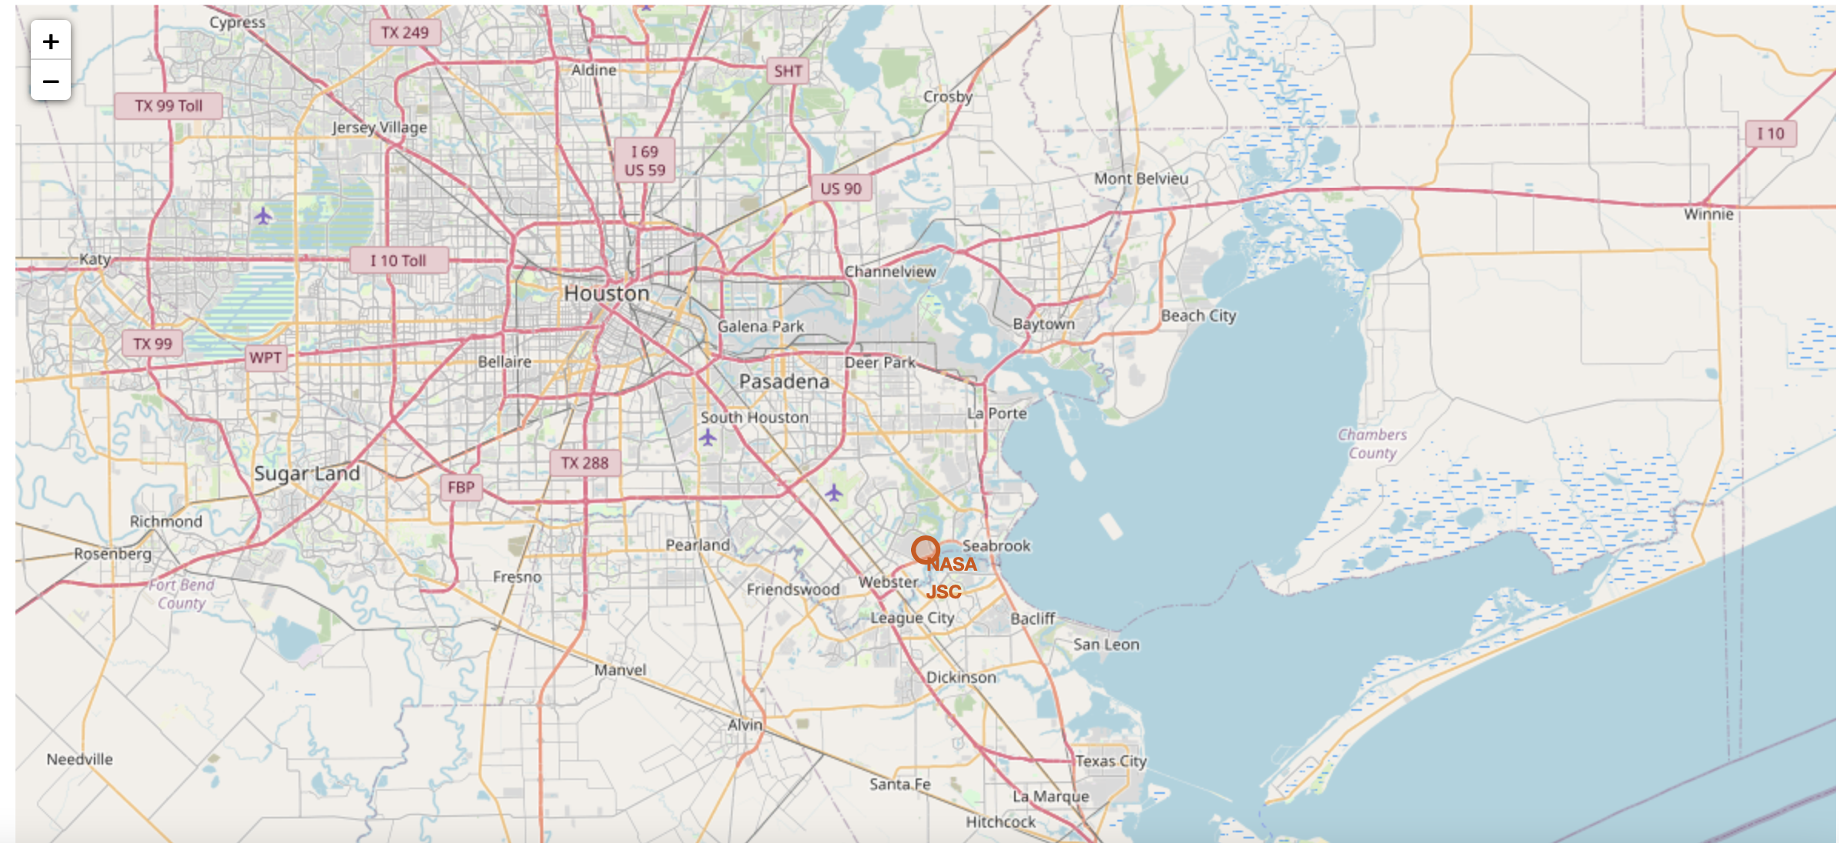
Results – Folium Maps

Slide 39
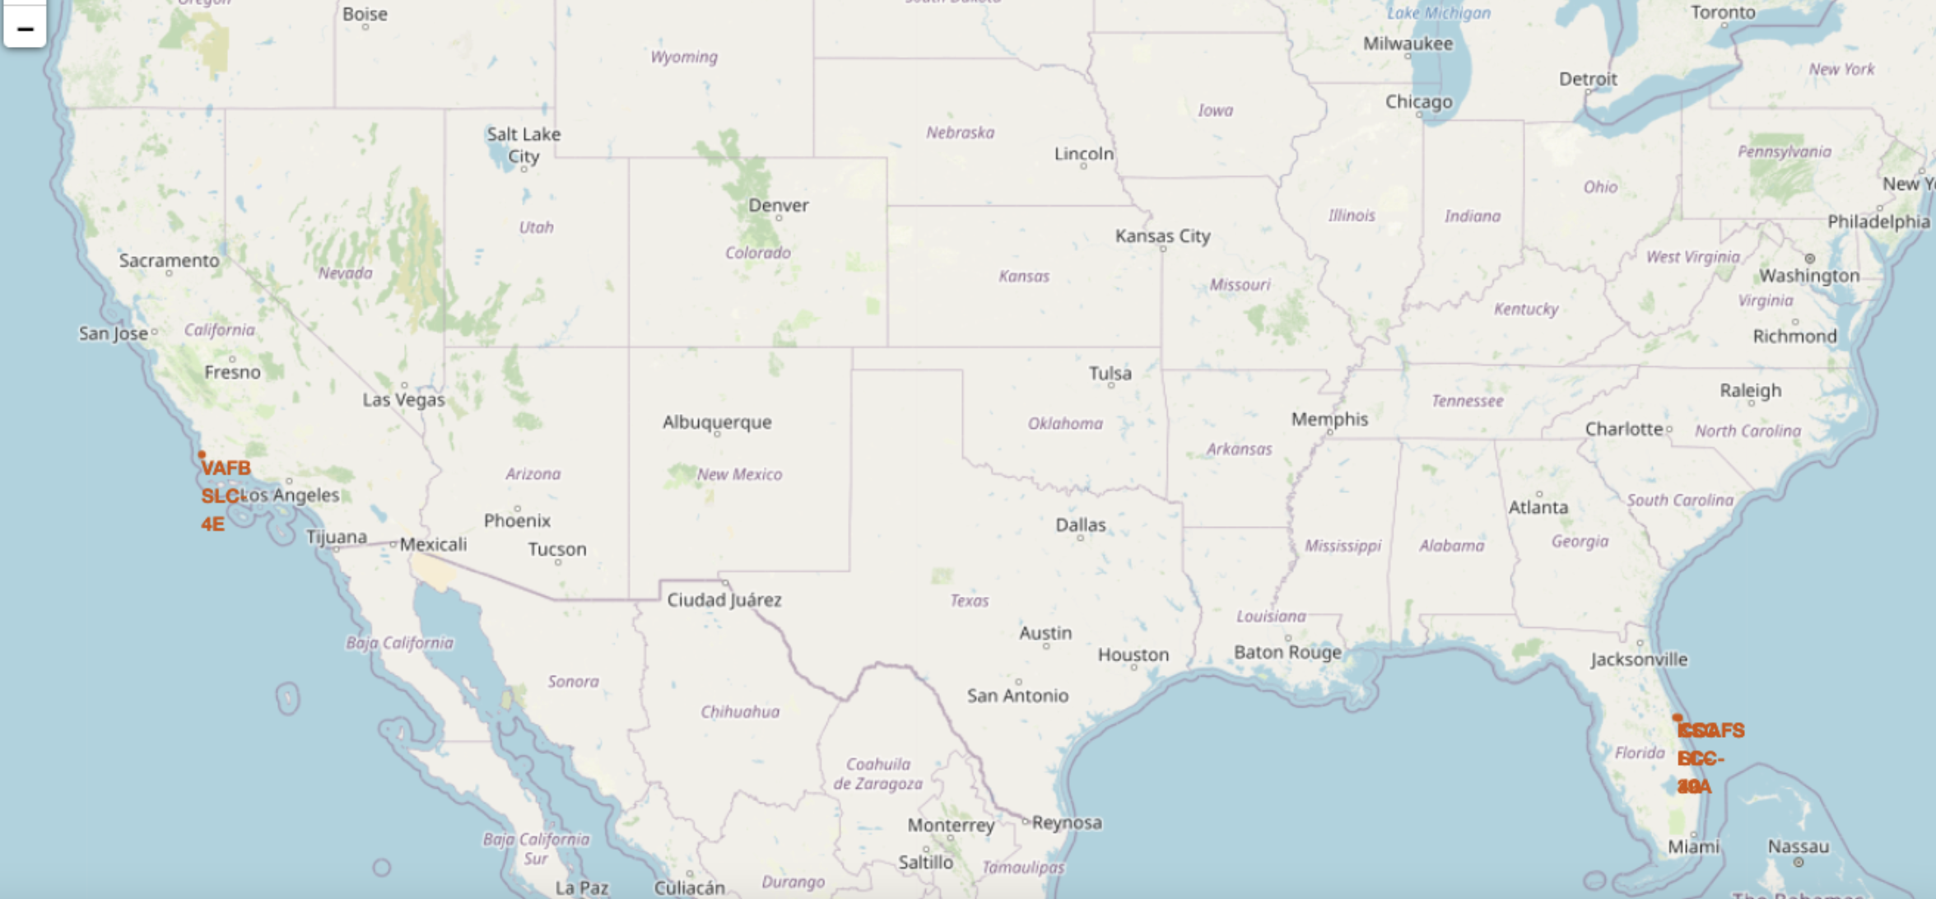
Results – Folium Maps

Slide 40
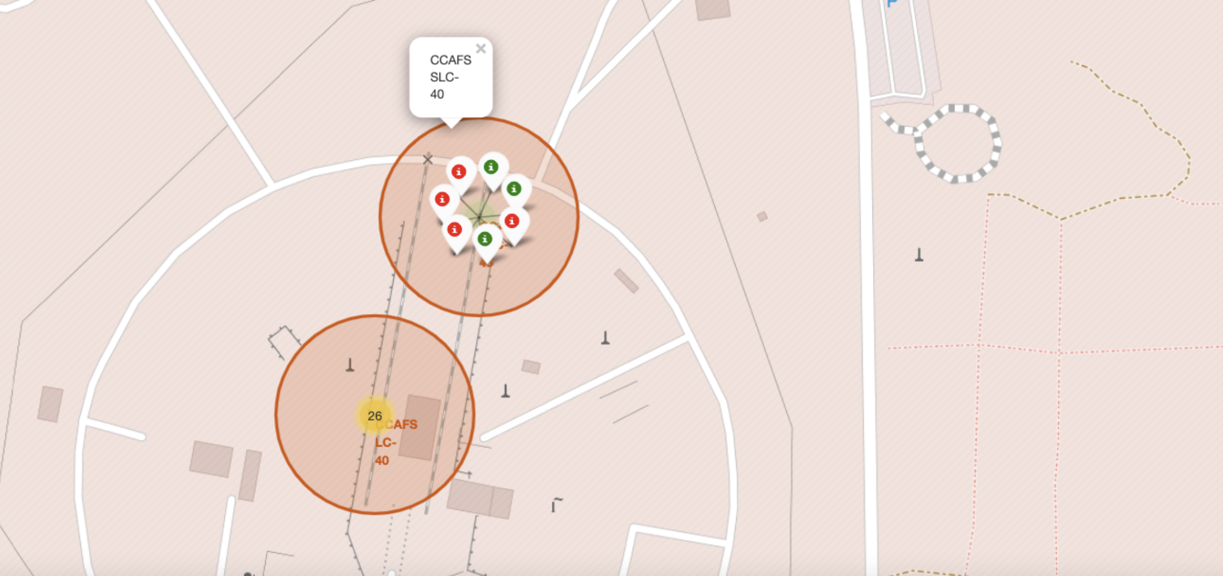
Results – Folium Maps

Slide 41
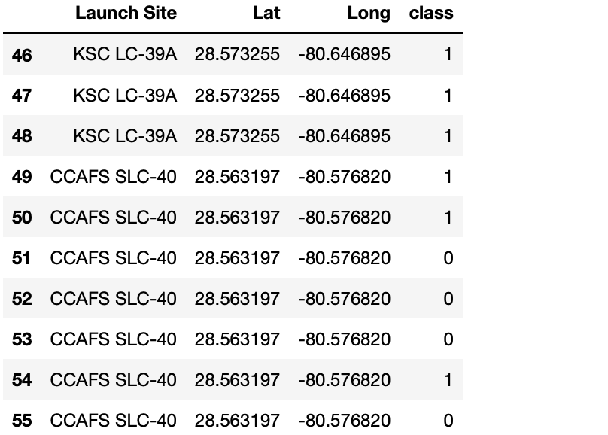
Results – Success/Failed Launches For Each Site Map
Class “1” indicates a successful launch and Class “0” indicates a failed launch.

Slide 42

Section 4
Dashboarding with Ploty Dash

Slide 43
Ploty Dash
While I am not able to provide images from Ploty Dash due to a Mac security measure, this visual tool permits the design of a dashboard that:
- enable Launch Site selection
- create pie chart to show the total successful launches count for all
sites
- Add slider to select payload range
- Create a scatter graph depicting the relationship between payload
and success for All Sites

Slide 44
Section 5
Predictive Analysis

Slide 45
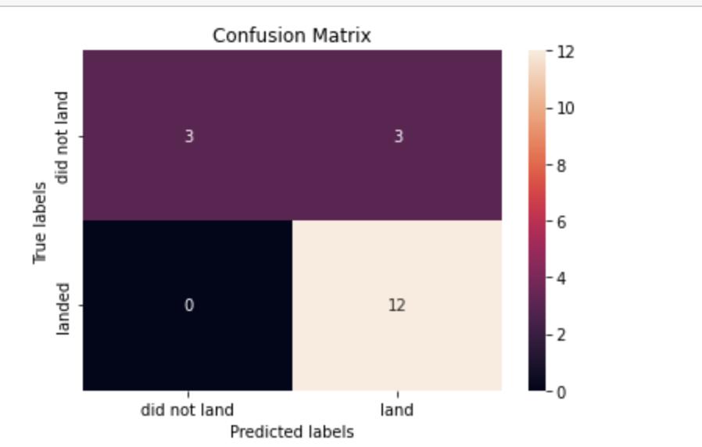
Results – Logistic Regression
GridSearchCV Score: 0.8464285714285713
Best Accuracy Score: 0.8333333333333334
Confusion Matrix: Examining the confusion matrix, we see that logistic regression can distinguish between the different classes. We see that the major problem is false positives.

Slide 46
Results – Logistic Regression
GridSearchCV Score: 0.8464285714285713
Best Accuracy Score: 0.8333333333333334
Confusion Matrix: Examining the confusion matrix, we see that logistic regression can distinguish between the different classes. We see that the major problem is false positives.

Slide 47
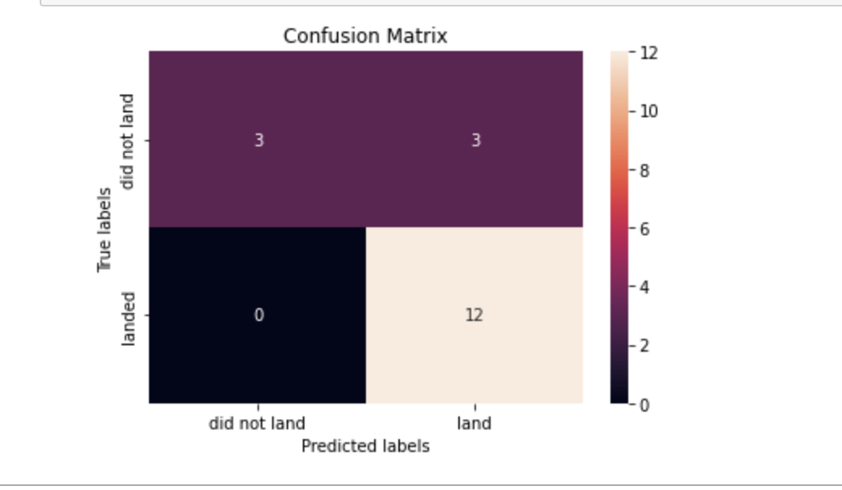
Results – Support Vector Machine(SVM)
GridSearchCV Score: 0.8482142857142856
Accuracy Score: 0.8333333333333334
Confusion Matrix:

Slide 48
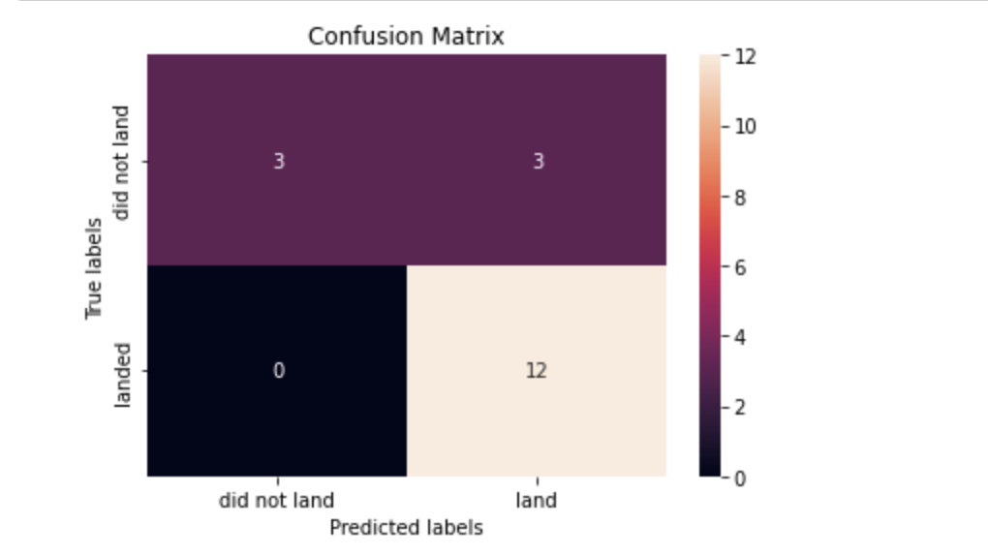
Results – Decision Tree Classifier
GridSearchCV Score: 0.8767857142857144
Accuracy Score: 0.8333333333333334
Confusion Matrix:

Slide 49
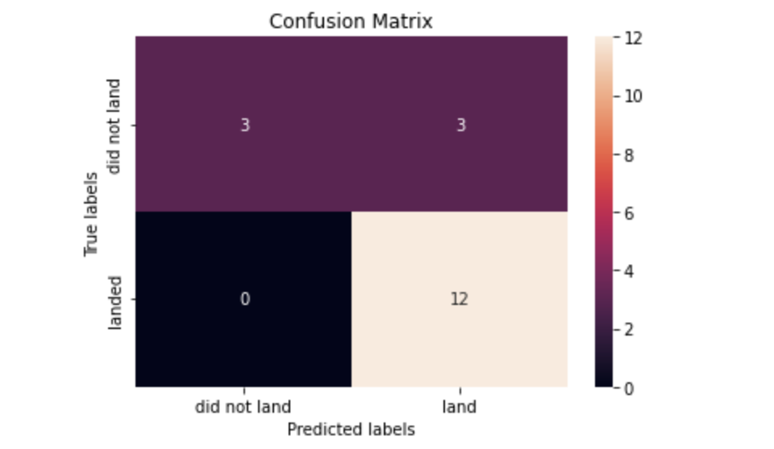
Results – K Nearest Neighbor (KNN)
GridSearchCV Score: 0.8482142857142858
Accuracy Score: 0.8333333333333334
Confusion Matrix:

Slide 50
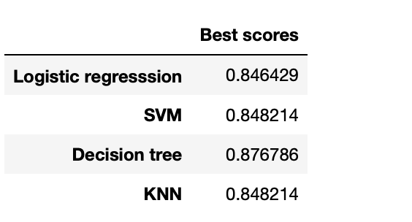
Results – Predictive Analysis
Considering all four models, it’s clear to see that they all returned the same Accuracy Scores as well as Confusion Matrix.
The alternative method of determining the most efficient model was to analyze the data by the best GridSearchCV scrore.
Hence, we can conclude that the “Decision Tree” model is the most efficient for prediction

Slide 51
Conclusions
Point 1 – The goal of this project was to determine the landing success rate for SpaceX Falcon9 at the first stage which would also impact the cost of launch.
Point 2 – After analyzing the date via Python libraries Panda & Numpy, in addition to using visualization tools such as Matplotlib & Folium, it’s evident that certain features of the launch may affect the success rate of the landing.
Point 3 – The features analyzed included the Flight Number, Date of launch, Year, Orbit, Pay Load Mass, and more. All or some of these features are pertinent to achieving a success first stage landing rate.
Point 4 – Lastly, the application of various Machine Learning algorithms, while performing predictive analysis, resulted in the conclusion that the Decision Tree model is the best algorithm to use because it had a high GridSearchCV score.

Slide 52


